Slide 1
Understanding Containers
Andrew Babiec
Boston Code Camp 31
2019-04-05

Slide 2
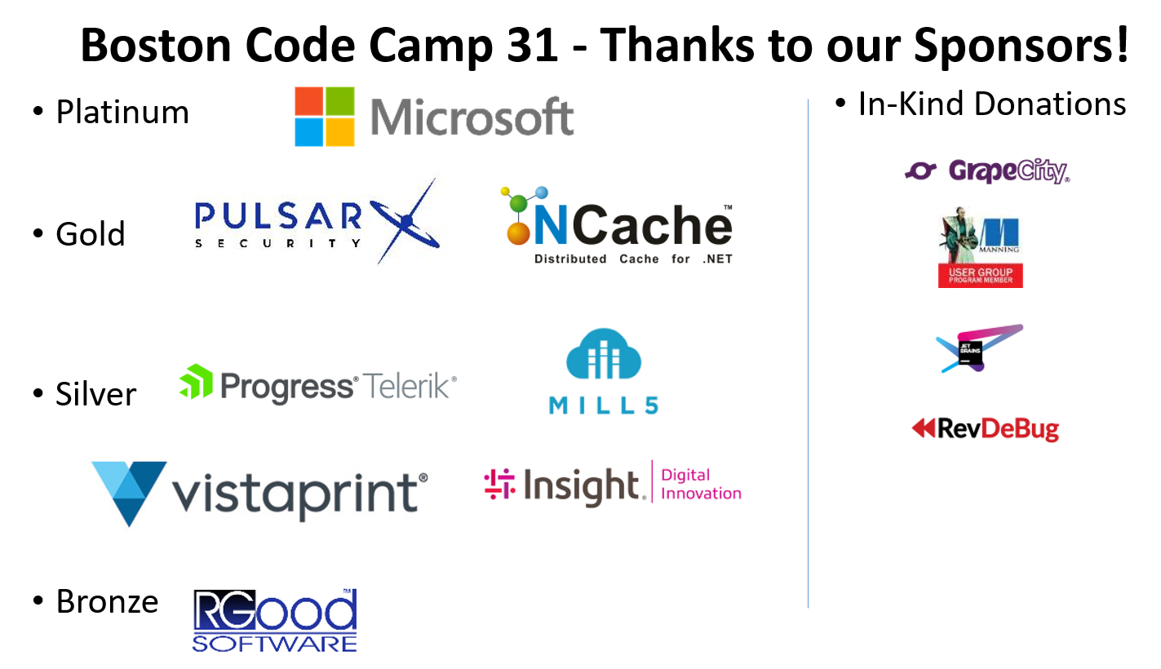

Slide 3
Overview
Introduction to Containers and Orchestration Engines
Covering Docker and Kubernetes
Including details on the differences between Windows and Linux
Slides: https://bit.ly/2I2BnkI

Slide 4
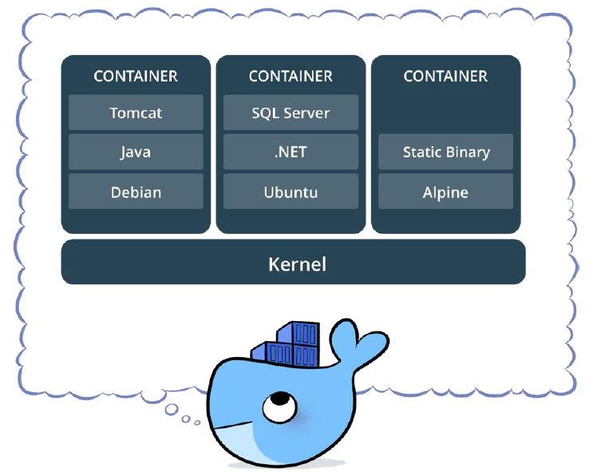
What is a Container?
Standardized packaging for software and dependencies
Isolate apps from each other
Share the same OS kernel
Supported on all major Linux distributions and Windows (10/Server 2016/2019)
Containerization is an approach to software development in which an application or service, its dependencies, and its configuration are packaged together as a container image

Slide 5
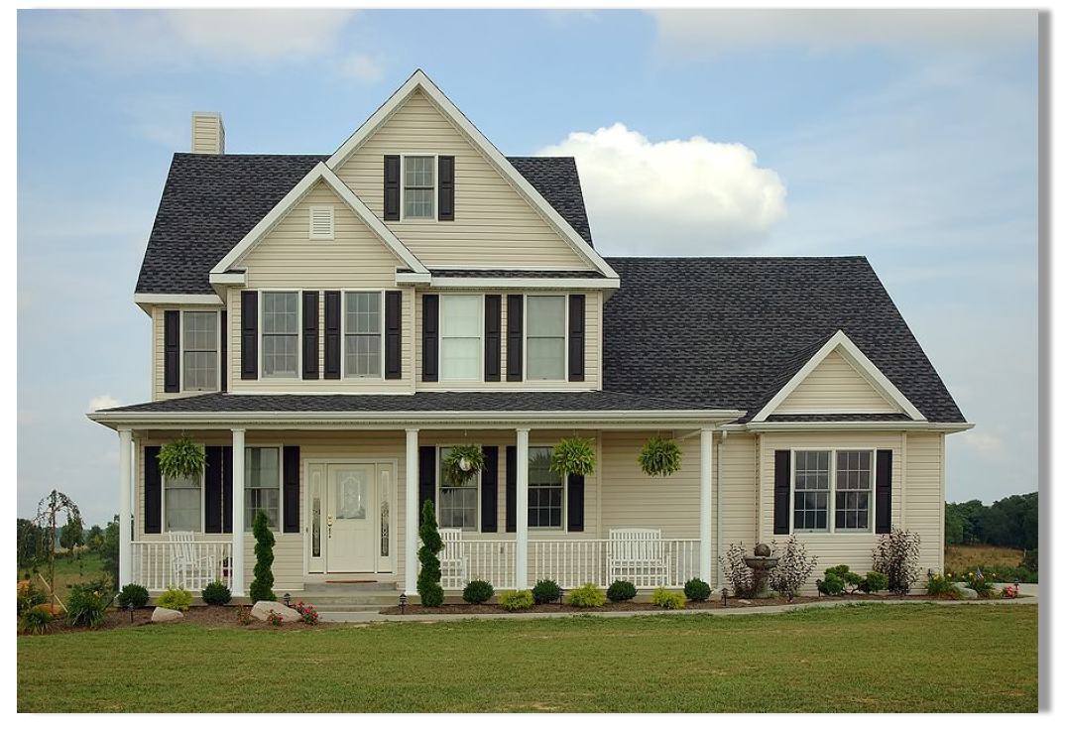
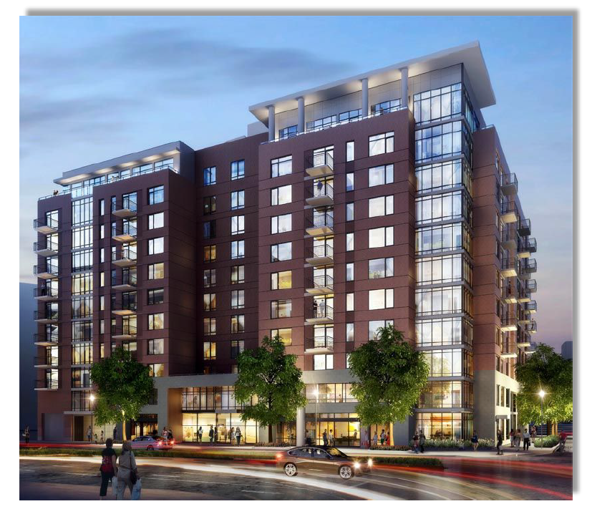
A Container is not a VM
Fundamentally different architecture & benefits
VM
Containers

Slide 6
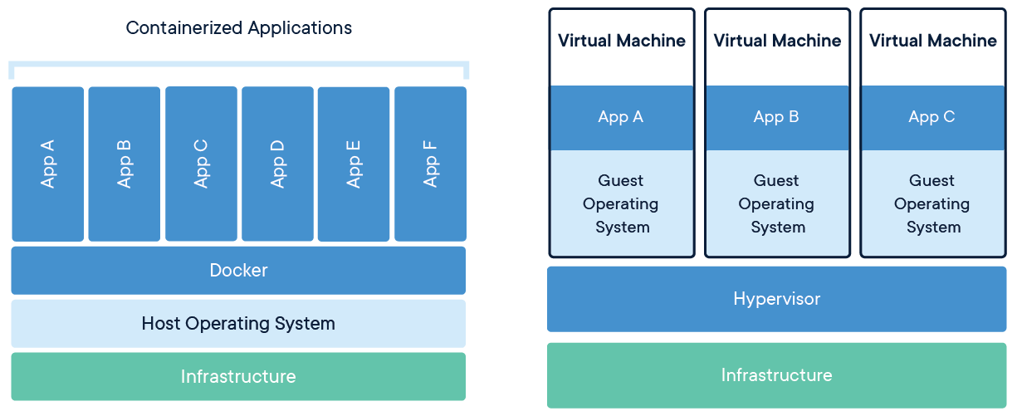

Slide 7
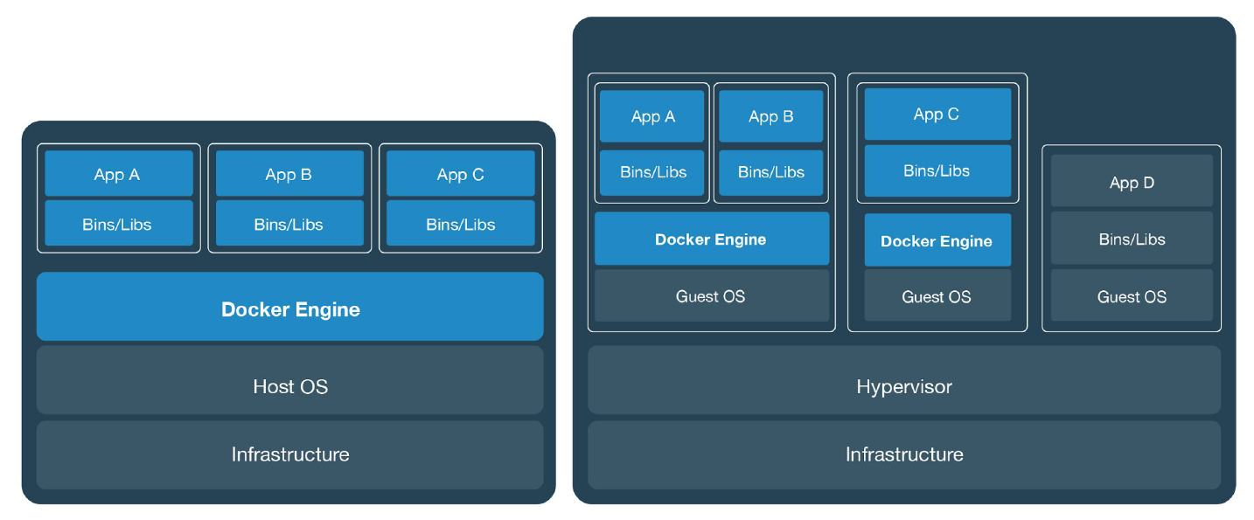
Can be combined together

Slide 8
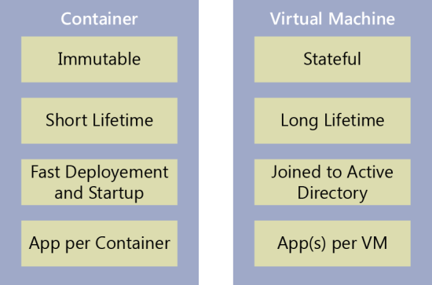

Slide 9
Why Containers?
Separation of concerns between Dev and Ops
Resource isolation/utilization
Portability
Scalability
Consistency across environments
External dependencies: framework, libraries, configuration, etc.
Supports CI/CD
Significantly smaller footprint than virtual machine (VM) images

Slide 10
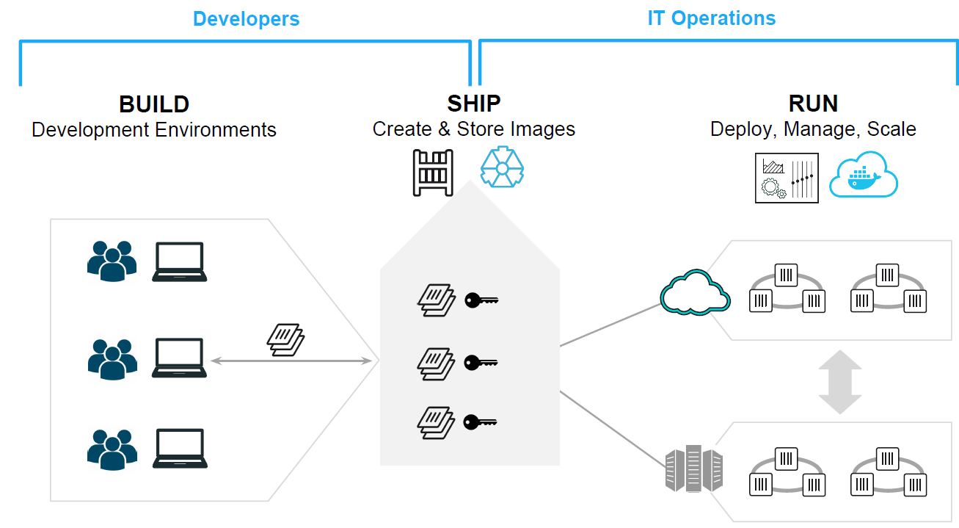
Using Containers – Separation of Concerns

Slide 11
How does it work?
Build on top of existing OS features
Kernel Namespaces - to sandbox different applications
process, network, filesystem, user
Control groups (cgroups) – control resource utilization
Layering – UnionFS
Components: container runtime, a network library, a RESTful API, a command-line interface, etc.

Slide 12
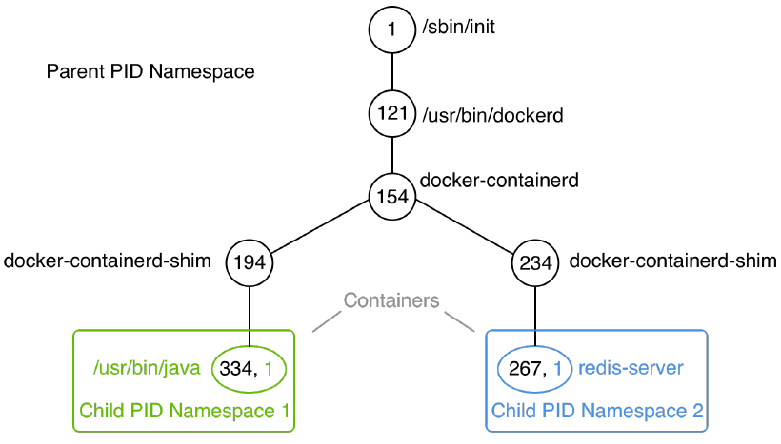
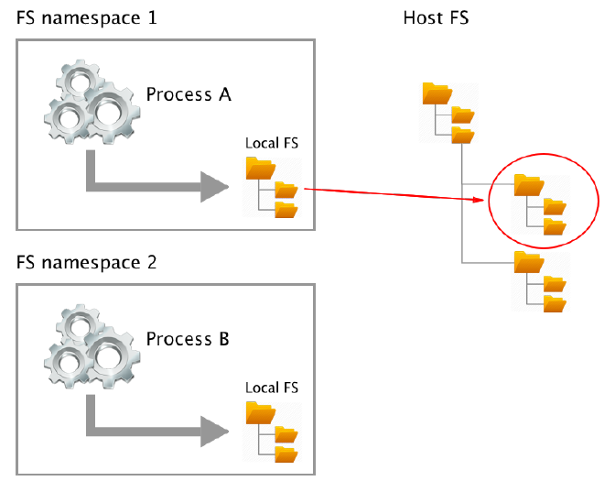
Namespaces

Slide 13
Drawbacks/Downsides
Less isolation than VMs
Shared OS Kernel will only support containers with the same OS
Training development and operations team members
Changes to workflow

Slide 14

Docker
Open-source project for automating the deployment of applications as portable, self-sufficient containers
Defacto standard: 95% usage share
Supports Linux and Windows

Slide 15
What Containers/Docker is NOT
Virtualization Platform
Cloud Platform
Config Mgmt (Puppet, Chef, etc.)
Deployment framework
Workload Mgmt (see Orchestration Engines later)

Slide 16
Docker editions: Community and Enterprise
Enterprise:
Enterprise-grade features such as role-based access control (RBAC), multi tenancy, mixed clusters of Docker Swarm and Kubernetes, web-based UI, and content trust, as well as image scanning on top of it.
Universal Control Plane (UCP) and Docker Trusted Registry (DTR)

Slide 17
Getting Started
Windows 10/Mac: Docker Desktop
Win10 requires HyperV
Older: Docker Toolbox
Windows Server 2016/2019: Docker Enterprise
Linux: Install Docker CE/EE

Slide 18
Docker vocabulary
Docker Image
The basis of a Docker container. Represents a full application
Docker Container
The standard unit in which the application service resides and executes
An instance of an image
Docker Engine
Creates, ships and runs Docker containers deployable on a physical or virtual, host locally, in a datacenter or cloud service provider
Registry Service (Docker Hub or Docker Trusted Registry)
Cloud or server based storage and distribution service for your images

Slide 19

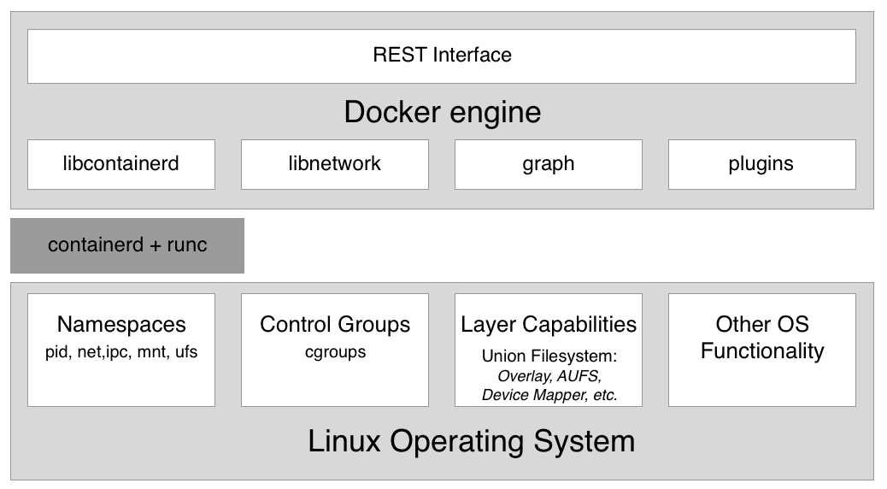
Docker Architecture

Slide 20
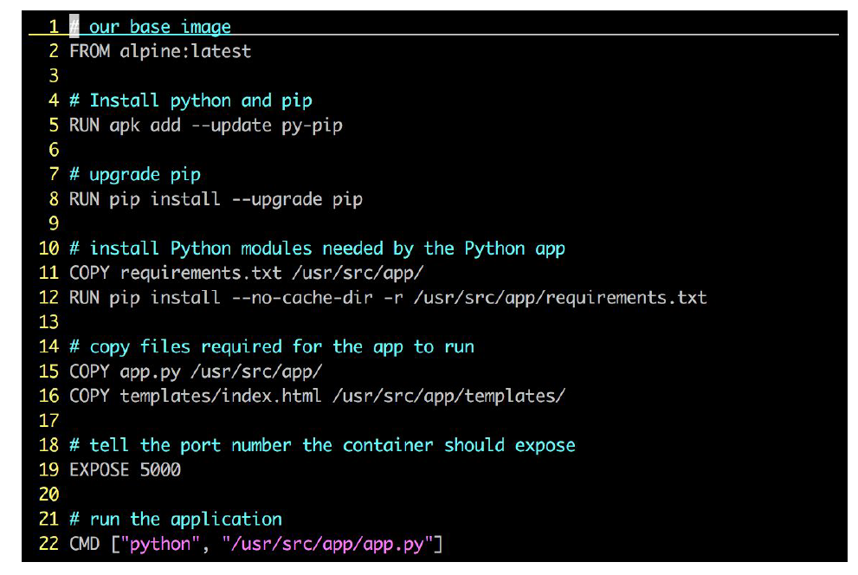
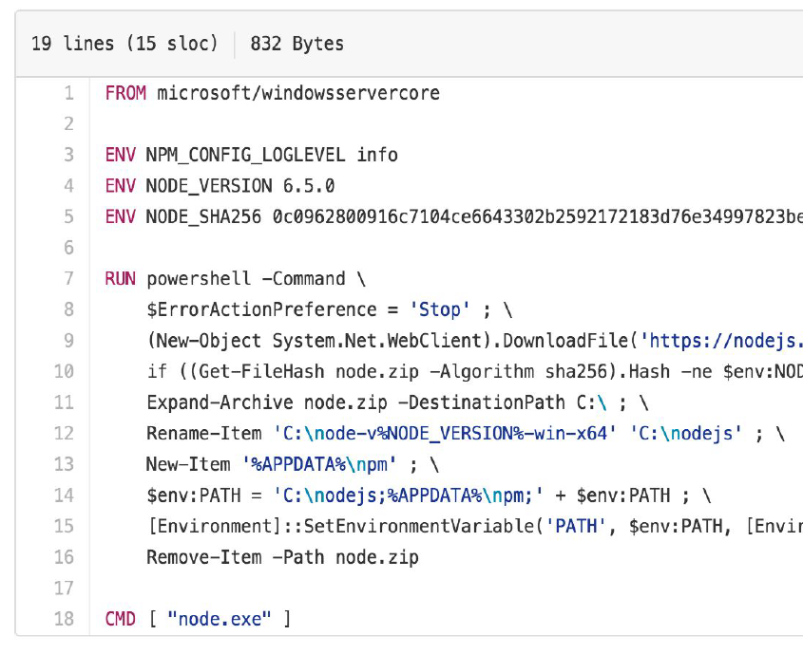
Building Images - DockerFile
Instructions on how to build a Docker image

Slide 21
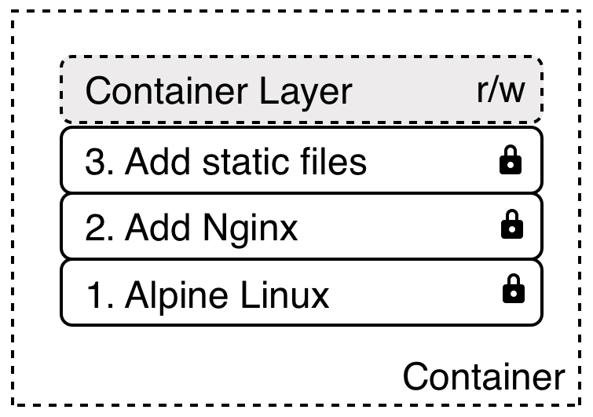
Dockerfile - Disk Layers
When a container is started a writeable layer is added to the “top” of the filesystem
Containers will share common layers on the host
Allows images to be constructed / deconstructed as needed vs. a huge monolithic image (ala traditional VM’s)

Slide 22
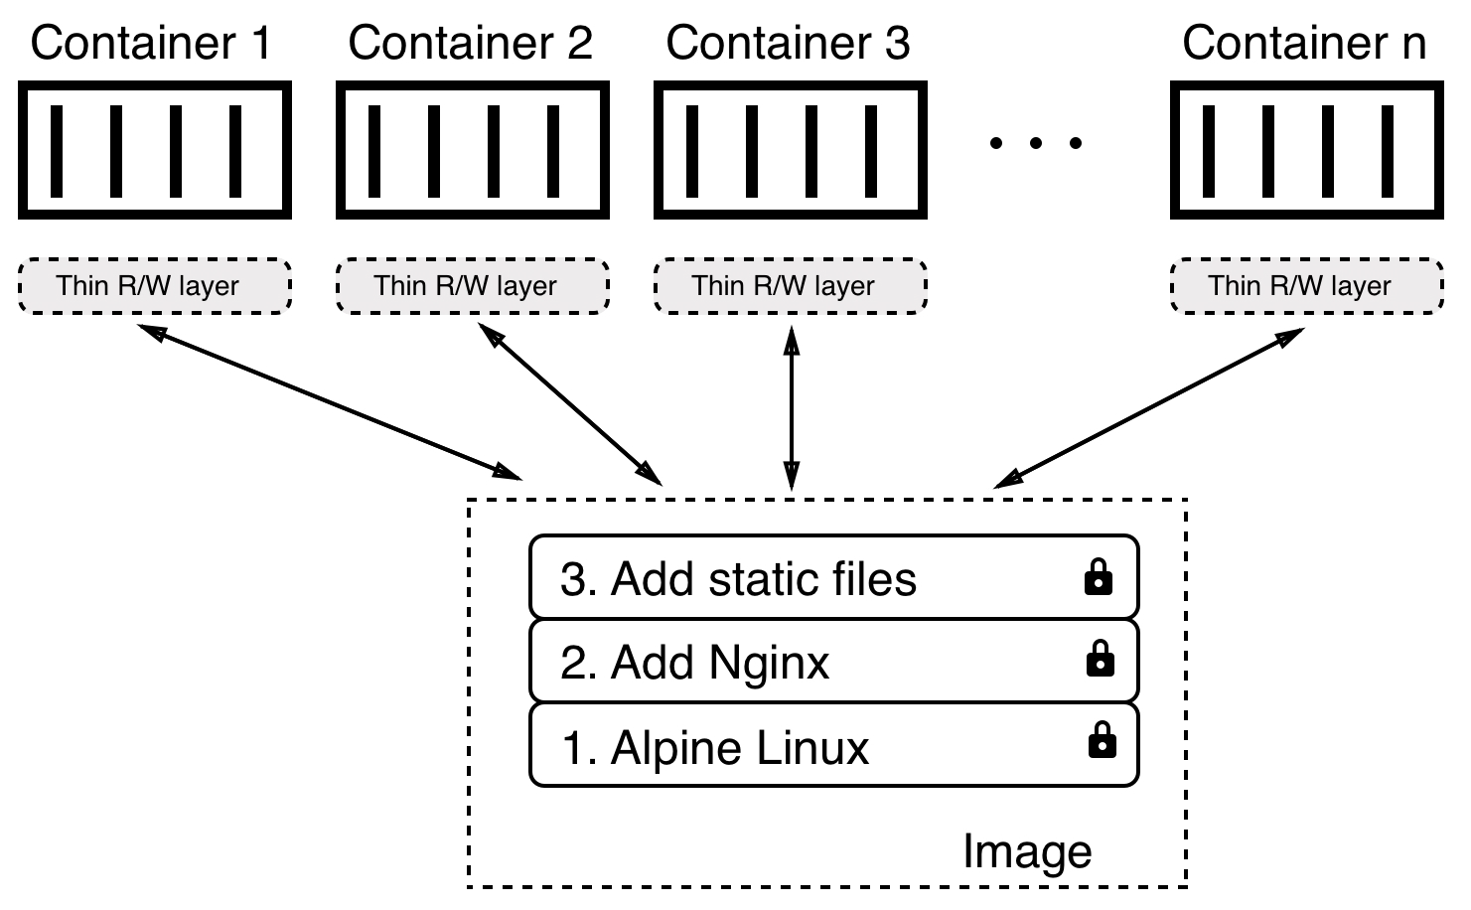
Shared Common Layers

Slide 23
Storage – Docker Volumes
Mount a directory on the host into the container at a specific location
Persistence (if container is deleted)
Share data between containers (or container and host)
Performance

Slide 24
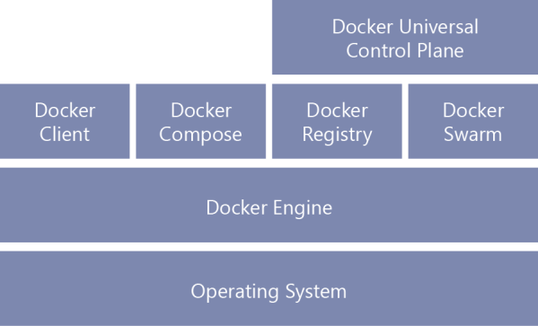
Docker Tools/Services
Docker Hub – online service for finding and sharing container images (registry)
Docker Compose - tool for defining and running multi-container Docker applications
Docker Swarm - group of machines (nodes) running Docker joined into a cluster
Stack - group of interrelated services that share dependencies, and can be orchestrated and scaled together
Docker Universal Control Plane – used for management

Slide 25
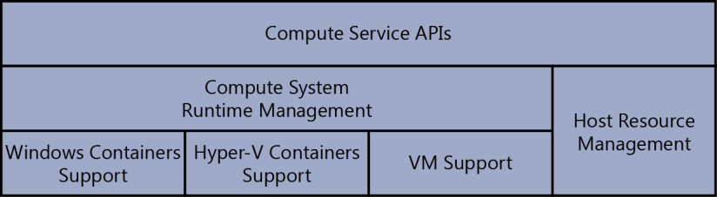
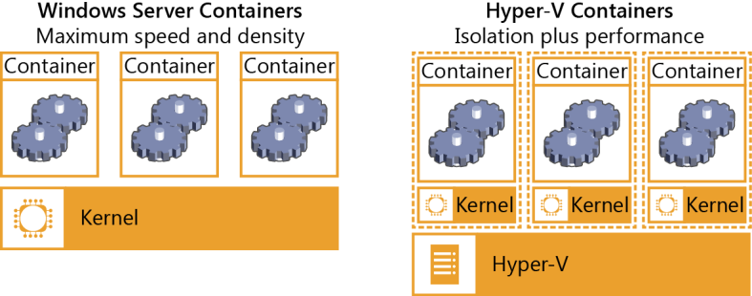
Windows Containers
Two types of runtime: Windows Server Container and Hyper-V Isolation

Slide 26
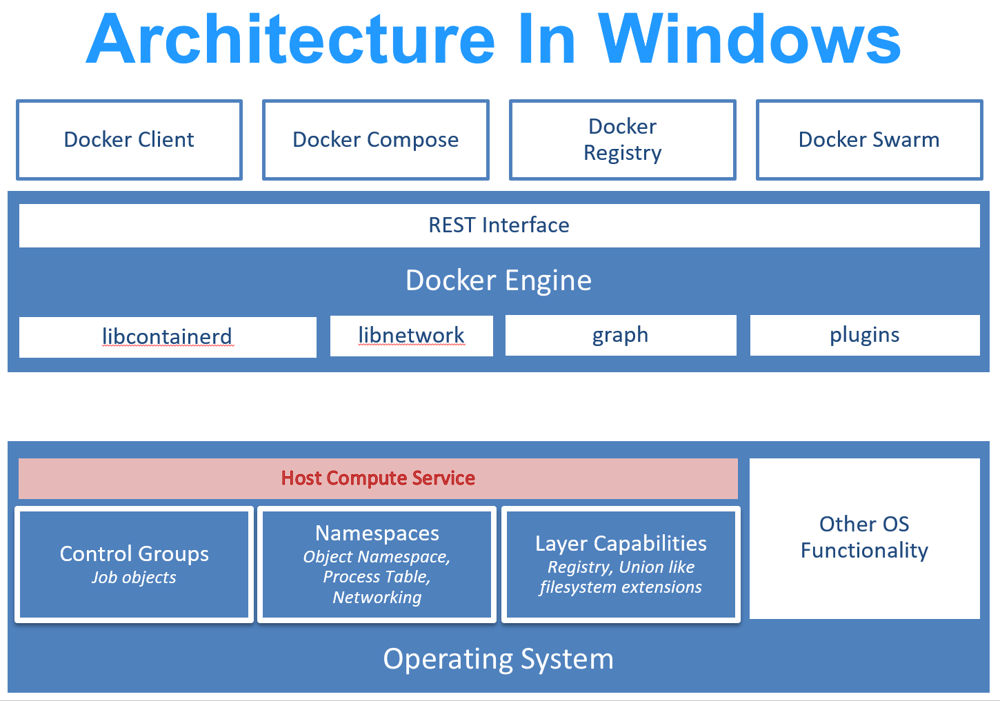
Windows Container Architecture
Containerd and runc replaced by Host Compute Service

Slide 27
Problem: Container Management
Higher-level Orchestration Engines to the rescue
Managing a multi-container application/system
Available Solutions:
Kubernetes
Docker SwarmKit
Apache Mesos
Azure Kubernetes Service (AKS)
AWS Elastic Container Service (ECS)
Red Hat Open Shift

Slide 28
Benefits of Orchestration Engines
Reconciling the desired state
Scaling up/down
Service discovery/Routing
Load Balancing
Self-healing - failover, health monitoring, uptime
Zero downtime deployments - rolling updates, canary releases, blue-green deployments
Affinity and location awareness
Security - network, RBAC, secrets, fresh rebuilds
Introspection - logging & monitoring
Automated rollouts & rollbacks

Slide 29
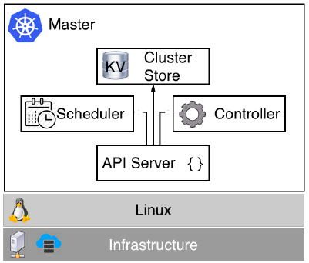
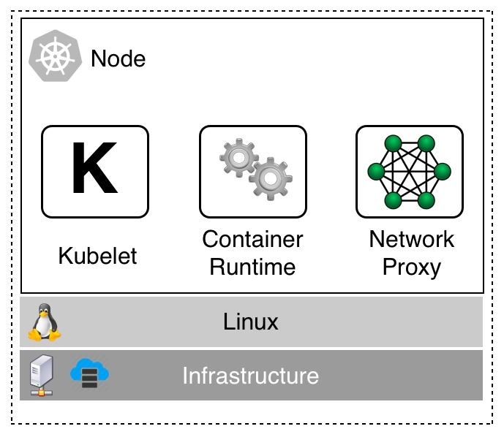
Kubernetes
Popular, widely-supported orchestration engine (even by Docker)
Master and (worker) Nodes

Slide 30
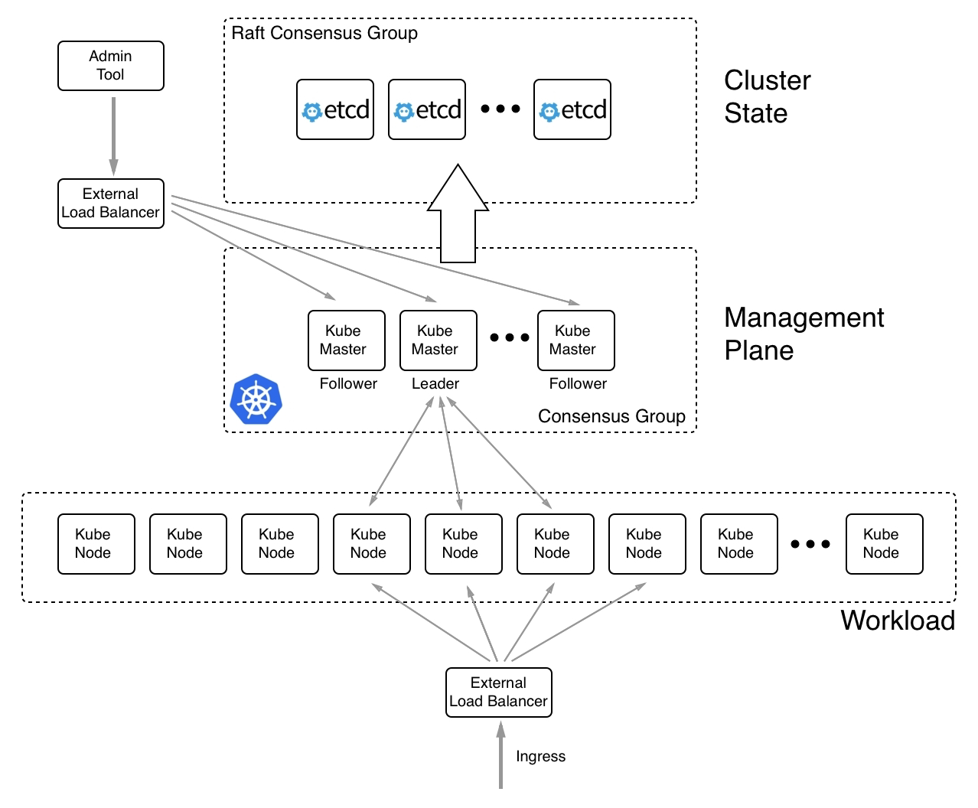
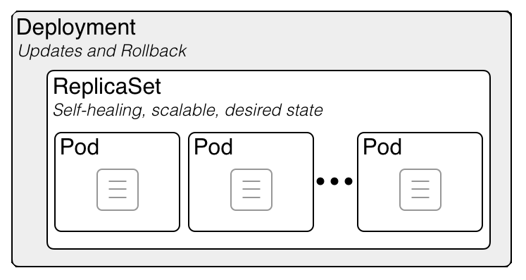

Slide 31
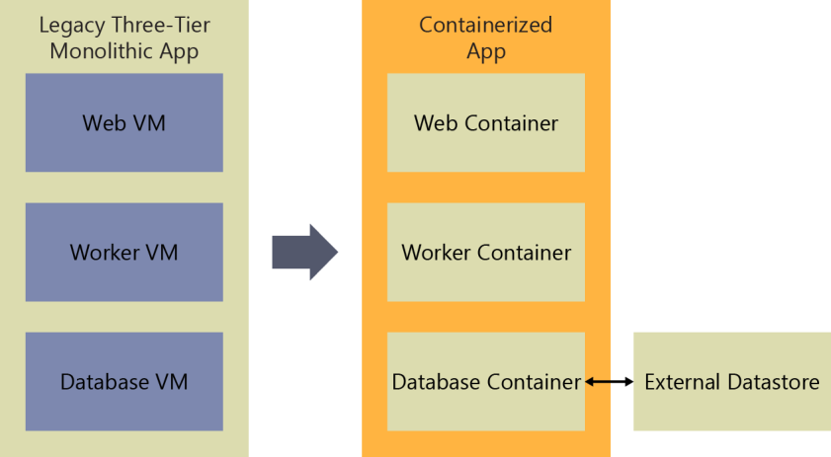
Migrating Existing Apps to Containers: Lift-and-shift

Slide 32
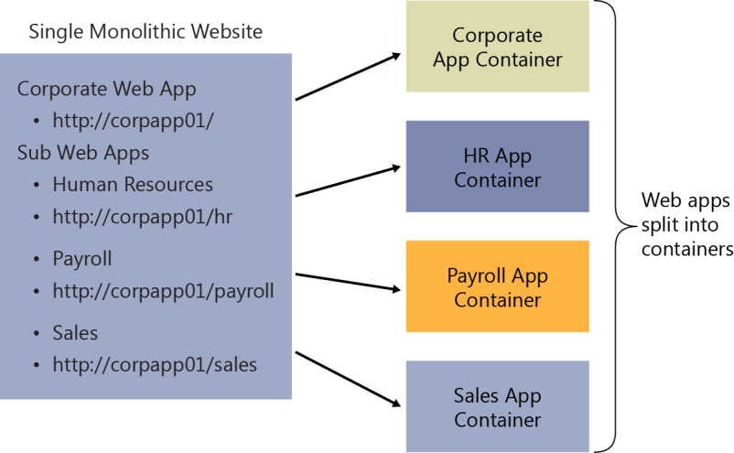
Migrating Existing Apps to Containers: Services

Slide 33
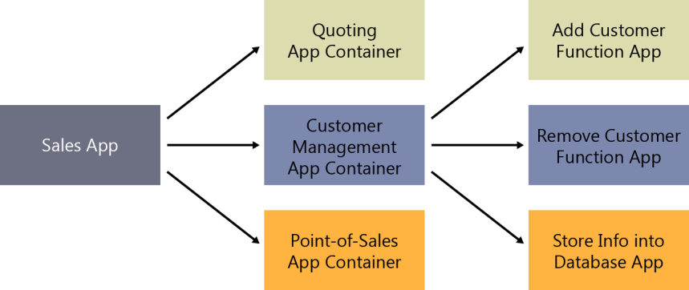
Migrating Existing Apps to Containers: Microservices

